Slide 1
Waterway-sunrise-i_655B

Slide 2
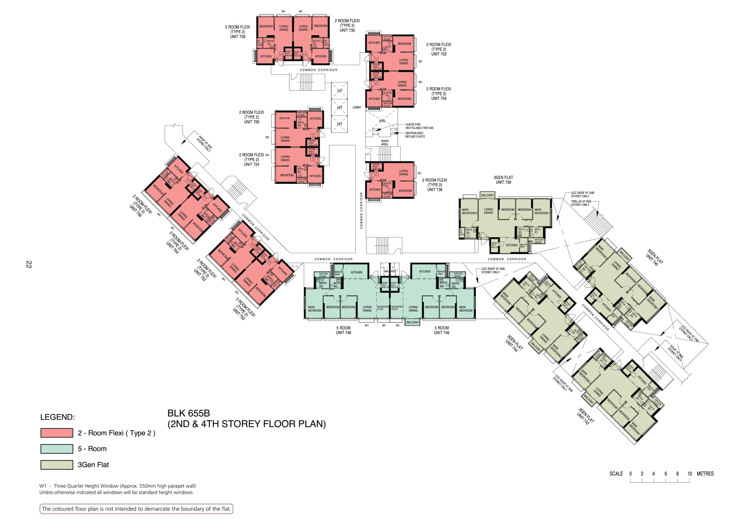

Slide 3
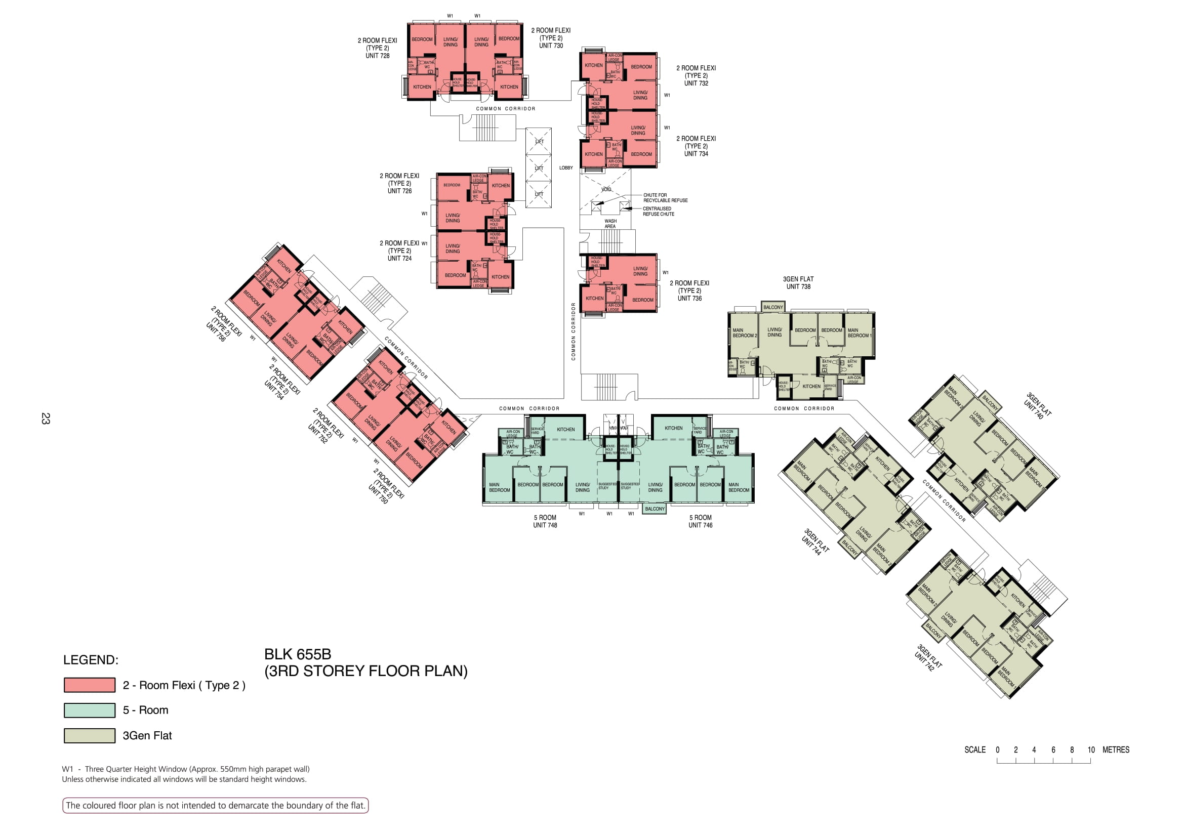

Slide 4


Slide 5


Slide 6


Slide 7


Slide 8
728
730
732
COMMON CORRIDOR
734
LOBBY
726
WASH
AREA
724
756
736
754
COMMON CORRIDOR
COMMON CORRIDOR
738
752
COMMON CORRIDOR
COMMON CORRIDOR
750
748
746
740
744
COMMON CORRIDOR
742

Slide 9
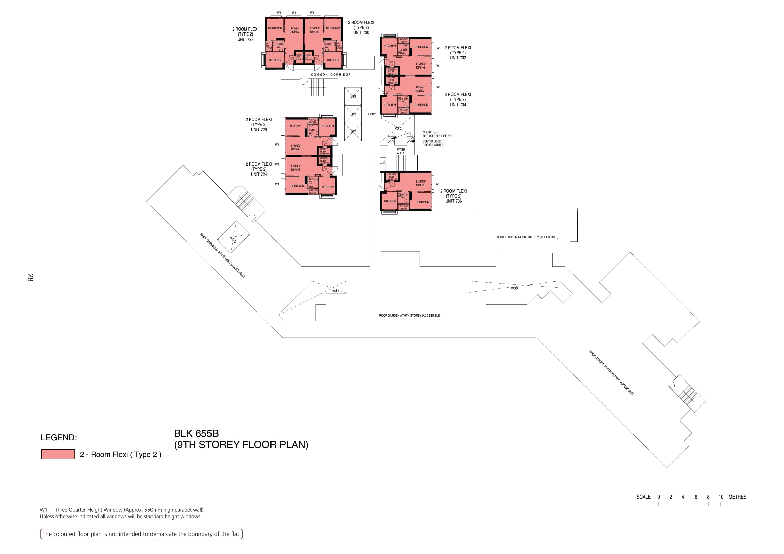

Slide 10
728
730
732
COMMON CORRIDOR
734
LOBBY
726
WASH
AREA
724
736
COMMON CORRIDOR
ROOF GARDEN
ROOF GARDEN
ROOF GARDEN
ROOF GARDEN

Slide 11
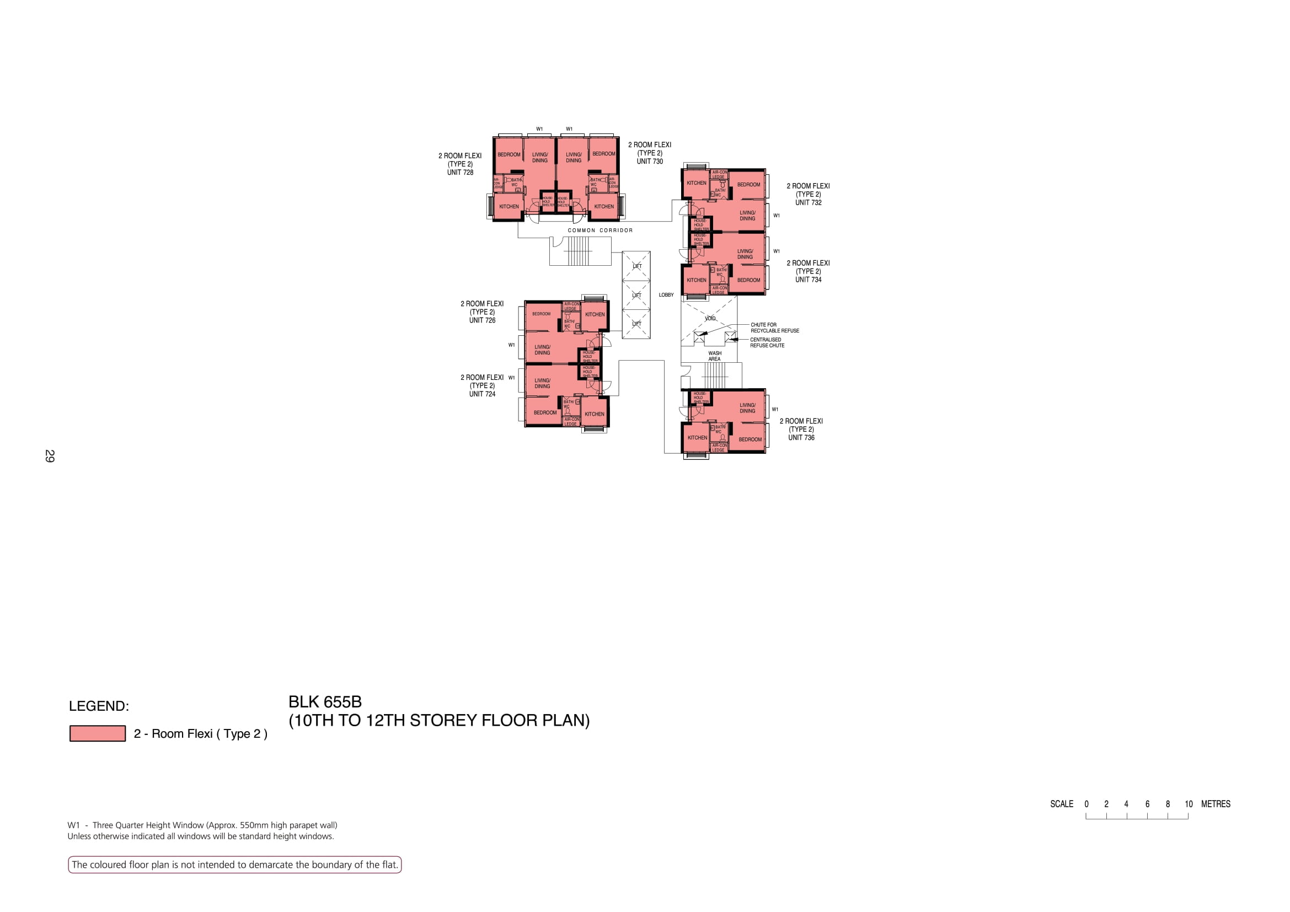

Slide 12
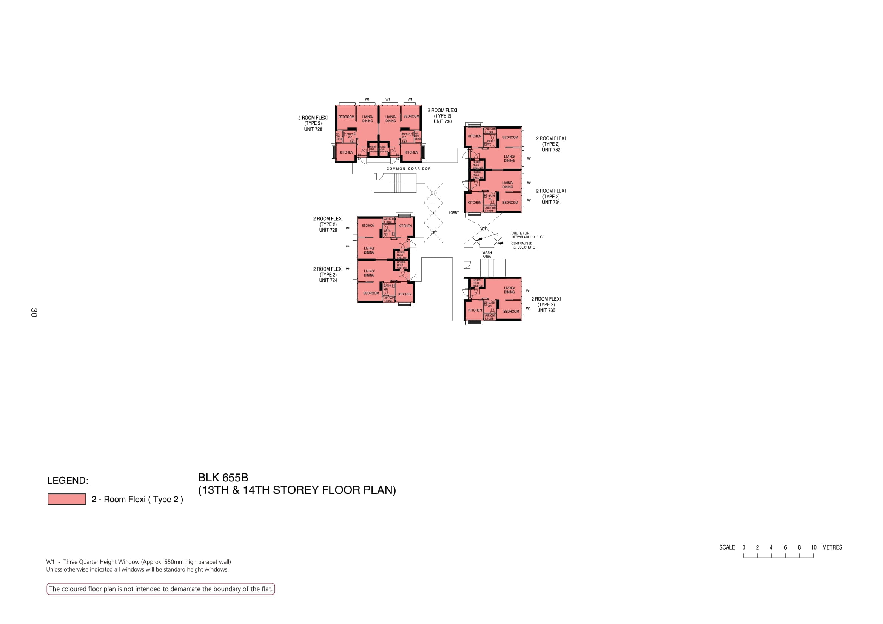

Slide 13
728
730
732
COMMON CORRIDOR
734
LOBBY
726
WASH
AREA
724
736

